Slide 1

Multi-view Video-conferencing in links
Caitlin McDougall

Slide 2
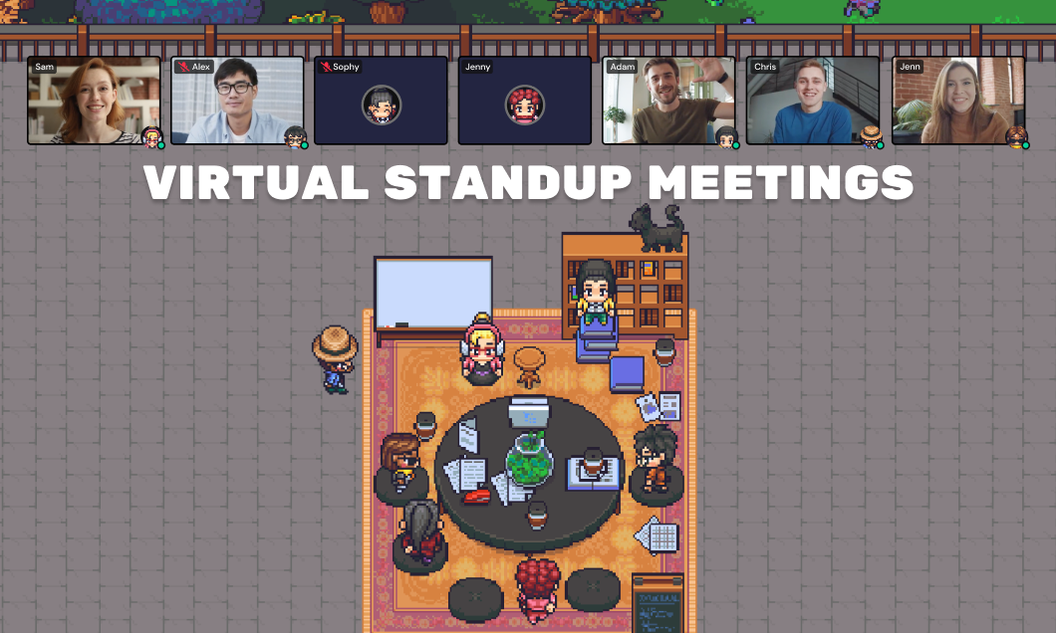
Background
Classic Web Development:
Many languages to learn
Links:
Single source
Compiles to JavaScript + SQL
Video-Conferencing:
Static
Zoom, Teams, Webex etc.
Spatial
Gather.town, FluidMeet
Proposal:
Links-based VCS
Support choice of view

Slide 3
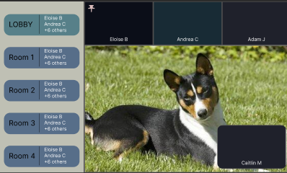
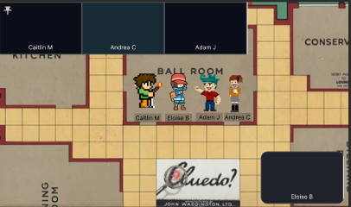
End Goal Designs
Static
Spatial

Slide 4
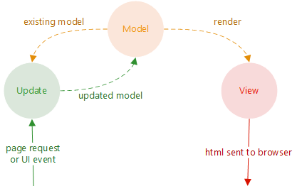
Approach
WebRTC
P2P connections
Links FFI
MDA
Model Driven Architecture
Abstract views from implementation
MVU
Model-View-Update
Enables side-effects
Spatial view
Underlying grid
Connect to current room
Challenges
Update on client movement

Slide 5
Demonstration

Slide 6
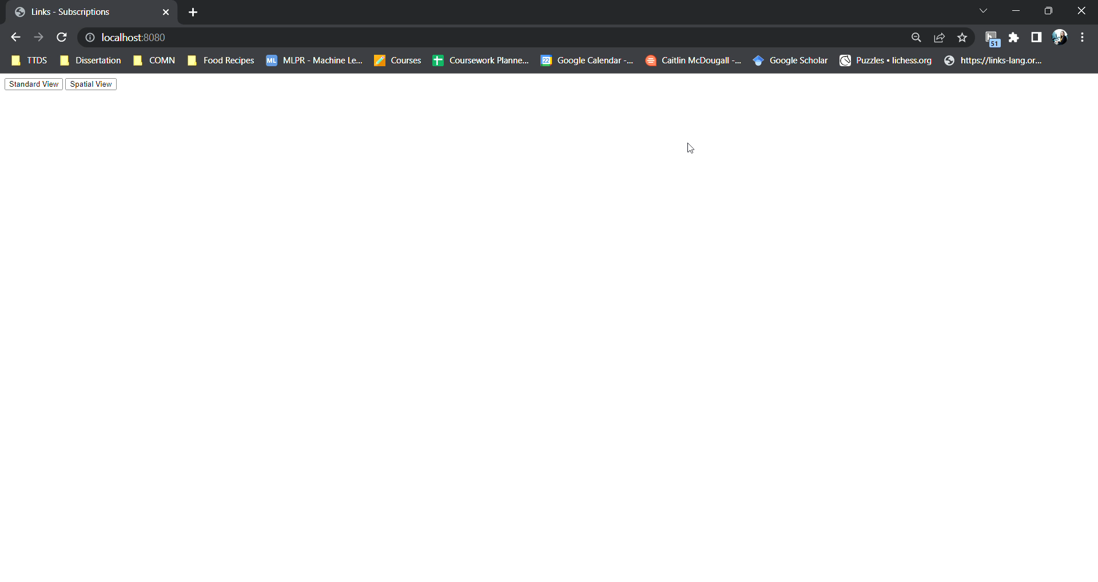

Slide 7
NEXT STEPS
Implement static view
3rd February
Integrate static and spatial view
17th February
Allow character + name selection
24th February

